Slide 1

21CSC203P -Advanced Programming Practice Unit-3 Advanced Java Programming Paradigms
APP Faculties
Department of Computational Intelligence
SRM Institute of Science and Technology

Slide 2
Outline of the Presentation
S-19: Concurrent Programming Paradigm
S-20: Multithreading and Multitasking
S-21: Thread classes and methods
S-22: Declarative Programming Paradigm: Java Database Connectivity (JDBC)
S-22: Connectivity with MySQL – Query Execution
S-23: Graphical User Interface Based Programming Paradigm
S-24: Java Applets-Basics
S-24: Java Swing
S-25: Model View Controller (MVC) and Widgets
Dr.Maivizhi Assistant Professor / CINTEL

Slide 3

Concurrent Programming Paradigm
Computing systems model the world, and the world contains actors that execute independently of, but communicate with, each other. In modelling the world, many (possibly) parallel executions have to be composed and coordinated, and that's where the study of concurrency comes in.
There are two common models for concurrent programming: shared memory and message passing.
Shared memory. In the shared memory model of concurrency, concurrent modules interact by reading and writing shared objects in memory.
Message passing. In the message-passing model, concurrent modules interact by sending messages to each other through a communication channel. Modules send off messages, and incoming messages to each module are queued up for handling
Dr.Maivizhi Assistant Professor / CINTEL

Slide 4

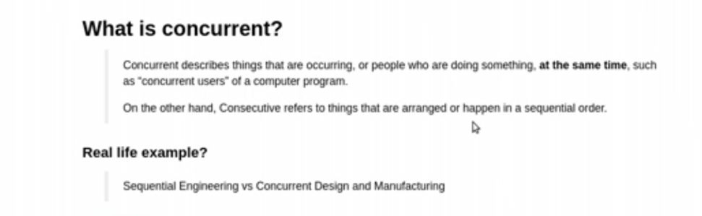
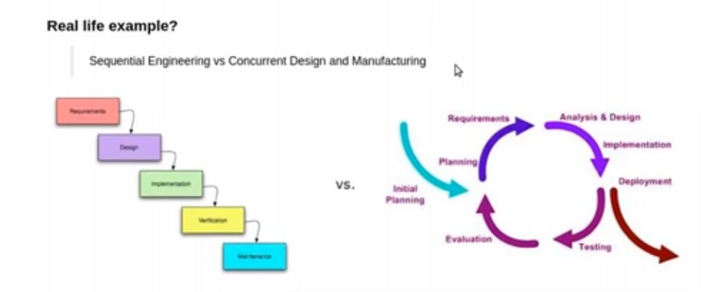
Dr.Maivizhi Assistant Professor / CINTEL

Slide 5
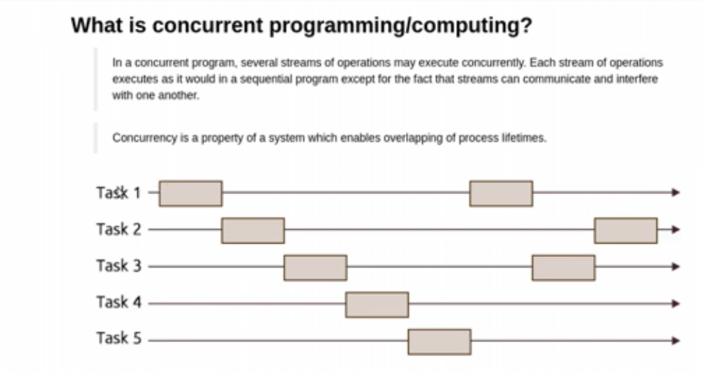
Dr.Maivizhi Assistant Professor / CINTEL

Slide 6
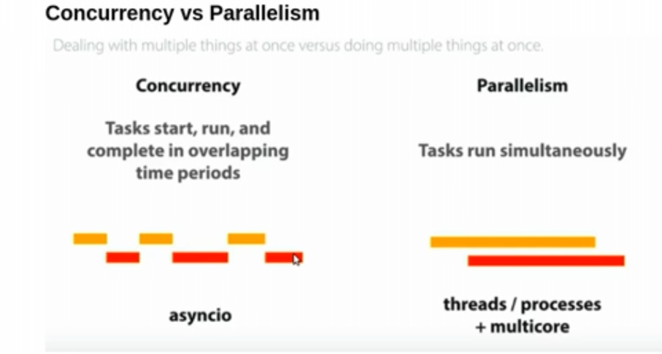
Dr.Maivizhi Assistant Professor / CINTEL

Slide 7
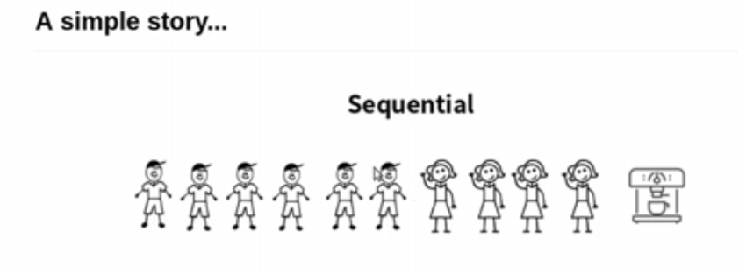
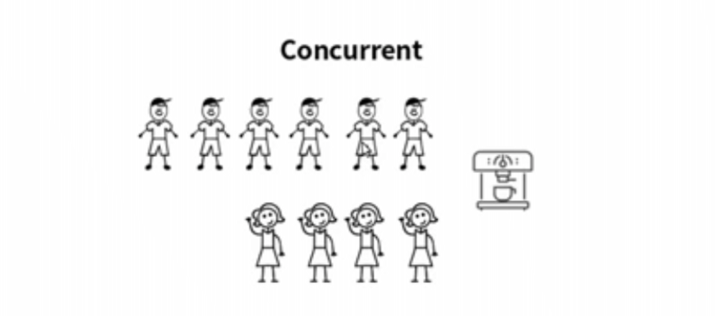
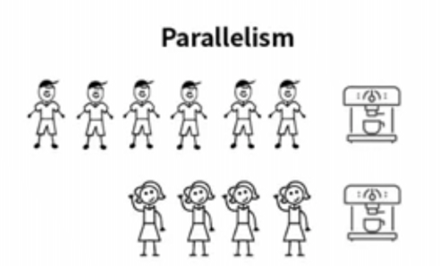
Dr.Maivizhi Assistant Professor / CINTEL

Slide 8
Issues Concurrent Programming Paradigm
Concurrent programming is programming with multiple tasks. The major issues of concurrent programming are:
Sharing computational resources between the tasks;
Interaction of the tasks.
Objects shared by multiple tasks have to be safe for concurrent access. Such objects are called protected. Tasks accessing such an object interact with each other indirectly through the object.
An access to the protected object can be:
Lock-free, when the task accessing the object is not blocked for a considerable time;
Blocking, otherwise.
Blocking objects can be used for task synchronization. To the examples of such objects belong:
Events;
Mutexes and semaphores;
Waitable timers;
Queues
Dr.Maivizhi Assistant Professor / CINTEL

Slide 9
Multithreaded Programming
Java provides built-in support for multithreaded programming.
A multithreaded program contains two or more parts that can run concurrently. Each part of such a program is called a thread, and each thread defines a separate path of execution. Thus, multithreading is a specialized form of multitasking.
There are two distinct types of multitasking: process-based and thread-based.
It is important to understand the difference between the two.
Dr.Maivizhi Assistant Professor / CINTEL

Slide 10
Process-based multitasking
Process-based multitasking is the more familiar form.
A process is, in essence, a program that is executing. Thus, process-based multitasking is the feature that allows your computer to run two or more programs concurrently.
For example, process-based multitasking enables you to run the Java compiler at the same time that you are using a text editor.
In process-based multitasking, a program is the smallest unit of code that can be dispatched by the scheduler.
Dr.Maivizhi Assistant Professor / CINTEL

Slide 11
Thread-based multitasking
Thread-based multitasking environment, the thread is the smallest unit of dispatchable code. This means that a single program can perform two or more tasks simultaneously.
For instance, a text editor can format text at the same time that it is printing, as long as these two actions are being performed by two separate threads.
Thus, process-based multitasking deals with the “big picture,” and thread-based multitasking handles the details.
Dr.Maivizhi Assistant Professor / CINTEL

Slide 12
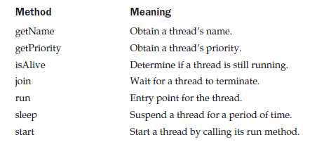
Thread Class and the Runnable Interface
Java’s multithreading system is built upon the Thread class, its methods, and its companion interface, Runnable. Thread encapsulates a thread of execution.
The Thread class defines several methods that help manage threads.
Dr.Maivizhi Assistant Professor / CINTEL

Slide 13
Main Thread
When a Java program starts up, one thread begins running immediately. This is
usually called the main thread of your program, because it is the one that is executed
when your program begins. The main thread is important for two reasons:
■ It is the thread from which other “child” threads will be spawned.
■ Often it must be the last thread to finish execution because it performs various shutdown actions.
Dr.Maivizhi Assistant Professor / CINTEL

Slide 14

Main Thread (Continue…)
Main thread is created automatically when your program is started, it can be controlled through a Thread object.
To do so, you must obtain a reference to it by calling the method currentThread( ), which is a public static member of Thread. Its general form is:
static Thread currentThread( )
This method returns a reference to the thread in which it is called. Once you have a reference to the main thread, you can control it just like any other thread.
Dr.Maivizhi Assistant Professor / CINTEL

Slide 15
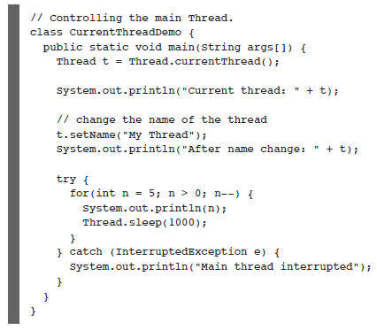
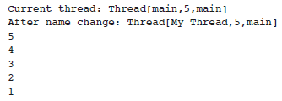

Example:
In this program, a reference to the current thread (the main thread, in this case) is obtained by calling currentThread( ), and this reference is stored in the local variable t.
Next, the program displays information about the thread. The program then calls setName( ) to change the internal name of the thread. Information about the thread is then redisplayed.
Next, a loop counts down from five, pausing one second between each line. The pause is accomplished by the sleep( ) method.
The argument to sleep( ) specifies the delay period in milliseconds. Notice the try/catch block around this loop.
The sleep( ) method in Thread might throw an InterruptedException.
This would happen if some other thread wanted to interrupt this sleeping one.
This example just prints a message if it gets interrupted. In a real program, you would need to handle this differently.
Output
Dr.Maivizhi Assistant Professor / CINTEL

Slide 16
Creating a Thread
In the most general sense, you create a thread by instantiating an object of type Thread.
Java defines two ways in which this can be accomplished:
■ You can implement the Runnable interface.
■ You can extend the Thread class, itself.
Dr.Maivizhi Assistant Professor / CINTEL

Slide 17
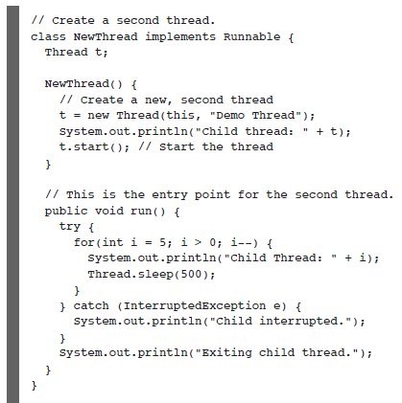
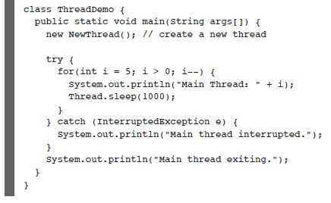
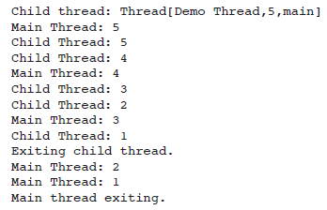
Example that creates a new thread and starts it running
Output
Dr.Maivizhi Assistant Professor / CINTEL

Slide 18
Extending Thread
The second way to create a thread is to create a new class that extends Thread, and then to create an instance of that class.
The extending class must override the run( ) method, which is the entry point for the new thread. It must also call start( ) to begin execution of the new thread.
The preceding program rewritten to extend Thread.
Dr.Maivizhi Assistant Professor / CINTEL

Slide 19
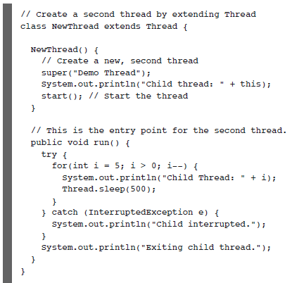
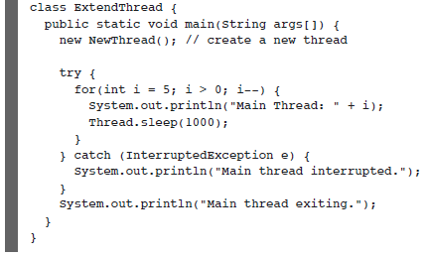
Extending Thread (Continue…)
Creating Multiple Threads
This program generates the same output as the preceding version.
Child thread is created by instantiating an object of NewThread, which is derived from Thread.
Dr.Maivizhi Assistant Professor / CINTEL

Slide 20
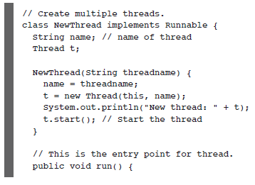
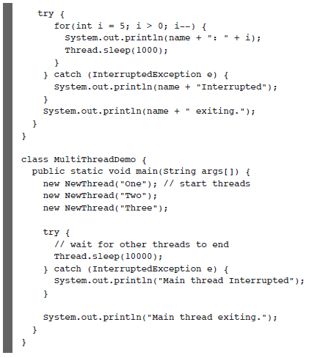
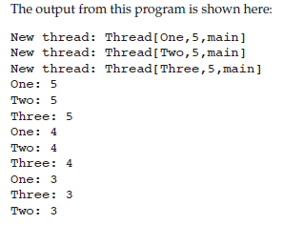
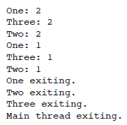
Creating Multiple Threads
Output
Dr.Maivizhi Assistant Professor / CINTEL

Slide 21

Using is Alive( ) and join( )
The main thread to finish last. In the preceding examples, this is accomplished by calling sleep( ) within main( ), with a long enough delay to ensure that all child threads terminate prior to the main thread.
Two ways exist to determine whether a thread has finished. First, you can call isAlive( ) on the thread. This method is defined by Thread, and its general form is shown here:
final boolean isAlive( )
The isAlive( ) method returns true if the thread upon which it is called is still running. It returns false otherwise.
While isAlive( ) is occasionally useful, the method that you will more commonly use to wait for a thread to finish is called join( ), shown here:
final void join( ) throws InterruptedException
Dr.Maivizhi Assistant Professor / CINTEL

Slide 22

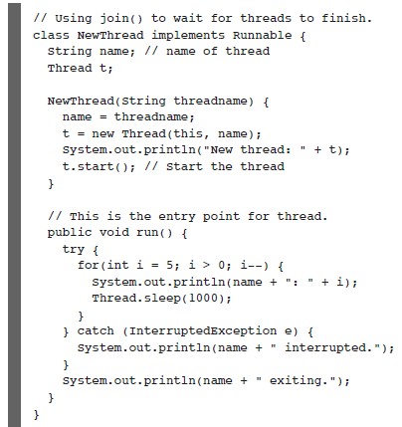
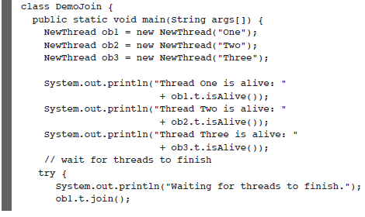
Example
Dr.Maivizhi Assistant Professor / CINTEL

Slide 23
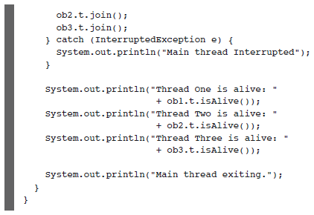
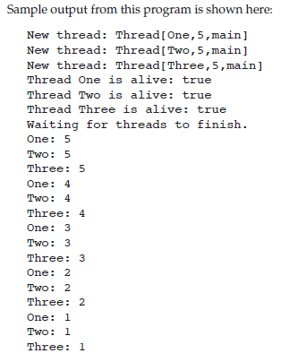
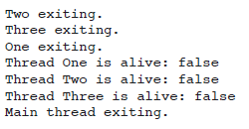
Example
Output
Dr.Maivizhi Assistant Professor / CINTEL

Slide 24
Thread Priorities
Thread priorities are used by the thread scheduler to decide when each thread should be allowed to run.
To set a thread’s priority, use the setPriority( ) method, which is a member of Thread. This is its general form:
final void setPriority(int level)
Here, level specifies the new priority setting for the calling thread. The value of level must be within the range MIN_PRIORITY and MAX_PRIORITY.
Currently, these values are 1 and 10, respectively. To return a thread to default priority, specify NORM_PRIORITY, which is currently 5. These priorities are defined as final variables within Thread.
You can obtain the current priority setting by calling the getPriority( ) method of Thread, shown here:
final int getPriority( )
Dr.Maivizhi Assistant Professor / CINTEL

Slide 25
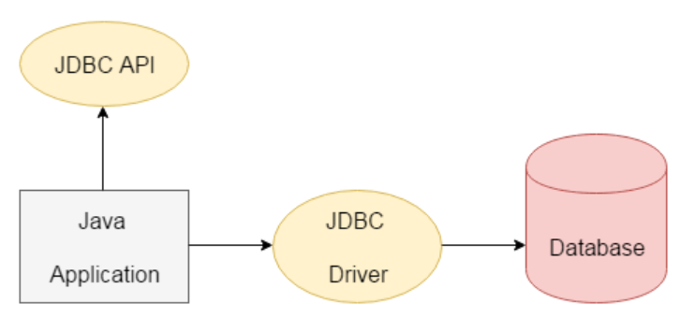
Java Database Connectivity (JDBC)
JDBC stands for Java Database Connectivity. JDBC is a Java API to connect and execute the query with the database. It is a part of JavaSE (Java Standard Edition). JDBC API uses JDBC drivers to connect with the database.
JDBC API to access tabular data stored in any relational database. By the help of JDBC API, we can save, update, delete and fetch data from the database.
Dr.Maivizhi Assistant Professor / CINTEL

Slide 26
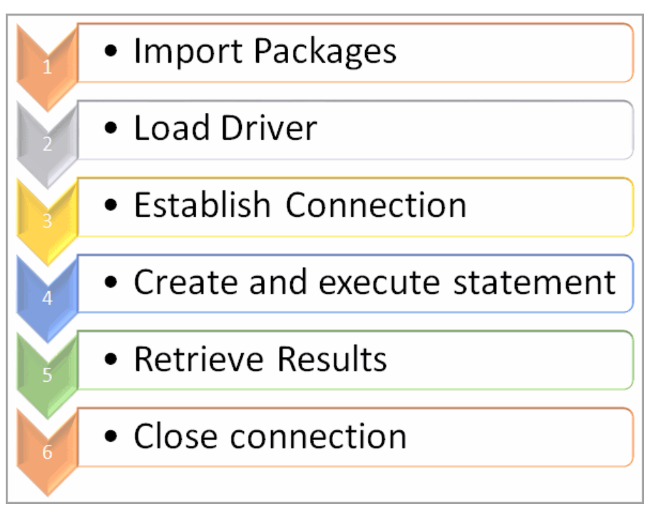
JDBC Connection Steps
There are 6 basic steps to connect with JDBC.
Dr.Maivizhi Assistant Professor / CINTEL

Slide 27
Import Packages
First, to import the existing packages to use it in our Java program. Import will make sure that JDBC API classes are available for the program. We can then use the classes and subclasses of the packages.
import java.sql.*;
JDBC API 4.0 mainly provides 2 important packages:
java.sql
javax.sql
Dr.Maivizhi Assistant Professor / CINTEL

Slide 28
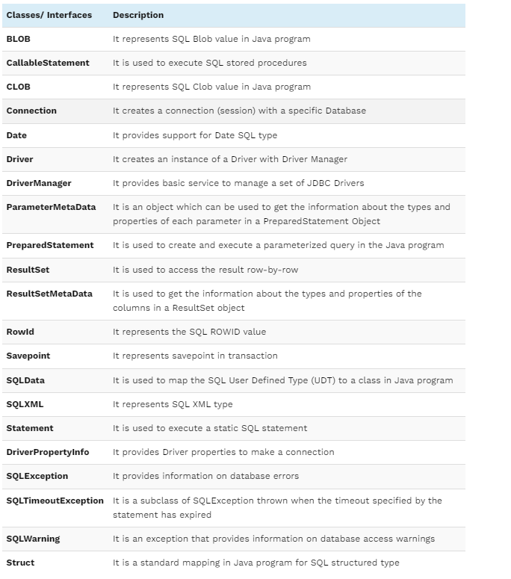
java.sql package
This package provides classes and interfaces to perform most of the JDBC functions like creating and executing SQL queries.
Dr.Maivizhi Assistant Professor / CINTEL

Slide 29
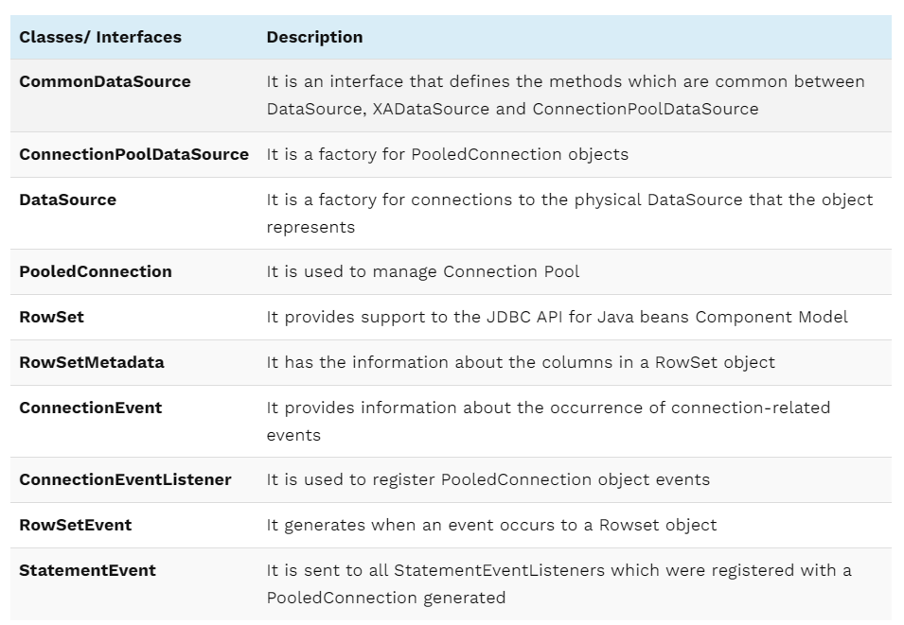
javax.sql package
It is a JDBC extension API and provides server-side data access and processing in Java Program.
Dr.Maivizhi Assistant Professor / CINTEL

Slide 30
Load Driver
First, we should load/register the driver in the program before connecting to the Database. You need to register it only once per database in the program.
We can load the driver in the following 2 ways:
Class.forName()
DriverManager.registerDriver()
Dr.Maivizhi Assistant Professor / CINTEL

Slide 31
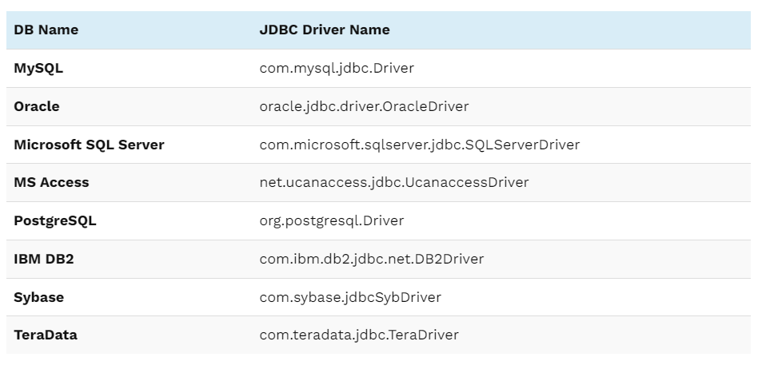
Class.forName()
In this way, the driver’s class file loads into the memory at runtime. It implicitly loads the driver. While loading, the driver will register with JDBC automatically.
Dr.Maivizhi Assistant Professor / CINTEL

Slide 32
DriverManager.registerDriver()
DriverManager is an inbuilt class that is available in the java.sql package.
It acts as a mediator between Java application and database which you want to connect. Before you connect with the database, you need to register the driver with DriverManager.
The main function of DriverManager is to load the driver class of the Database and create a connection with DB.
Public static void registerDriver(driver) – This method will register the driver with the Driver Manager. If the driver is already registered, then it won’t take any action.
It will throw SQLException if the database error occurs.
It will throw NullPointerException if the driver is null.
DriverManager.registerDriver(new oracle.jdbc.driver.OracleDriver())
DriverManager.registerDriver(new com.microsoft.sqlserver.jdbc.SQLServerDriver())
Dr.Maivizhi Assistant Professor / CINTEL

Slide 33
Establish Connection
After loading the driver, the next step is to create and establish the connection. Once required, packages are imported and drivers are loaded and registered, then we can go for establishing a Database connection.
DriverManager class has the getConnection method, we will use this method to get the connection with Database.
To call getConnection() method, we need to pass 3 parameters. The 3 parameters are string data type URL, a username, and a password to access the database.
The getConnection() method is an overloaded method. The 2 methods are:
getConnection(URL,username,password); – It has 3 parameters URL, username, password.
getConnection(URL); – It has only one parameter. URL has a username and password also.
Dr.Maivizhi Assistant Professor / CINTEL

Slide 34
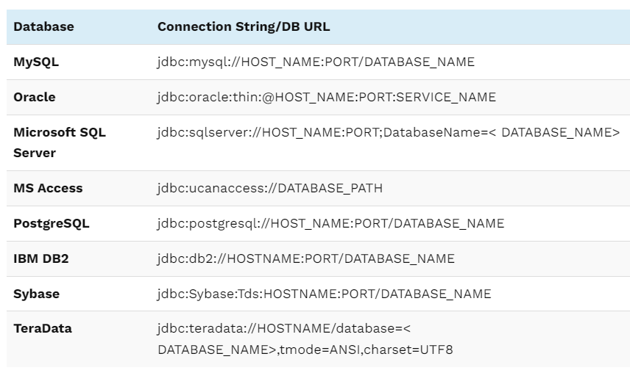
Establish Connection
The following table lists the JDBC connection strings for the different databases:
Example:
Connection con = DriverManager.getConnection(jdbc:oracle:thin:@localhost:1521:xe,System,Pass123@)
Here in this example,
thin refers to the Driver type.
localhost is where the Oracle database is running.
1521 is the port number to connect to DB.
xe – SID
System – User name to connect to the Oracle Database.
Pass123@ – Password
Dr.Maivizhi Assistant Professor / CINTEL

Slide 35
Create And Execute Statement
Once the connection has established, we can interact with the connected Database. First, we need to create the statement to perform the SQL query and then execute the statement.
(i) Create Statement
Now we will create the statement object that runs the query with the connected database. We use the createStatement method of the Connection class to create the query.
There are 3 statement interfaces are available in the java.sql package. These are explained below:
a) Statement
This interface is used to implement simple SQL statements with no parameter. It returns the ResultSet object.
Statement statemnt1 = conn.createStatement();
Dr.Maivizhi Assistant Professor / CINTEL

Slide 36
Create And Execute Statement
b) PreparedStatement
This PreparedStatement interface extends the Statement interface. So, it has more features than the Statement interface. It is used to implement parameterized and precompiled SQL statements. The performance of the application increases because it compiles the query only once.
It is easy to reuse this interface with a new parameter. It supports the IN parameter. Even we can use this statement without any parameter.
String select_query = “Select * from states where state_id = 1”;
PreparedStatement prpstmt = conn.prepareStatement(select_query);
Dr.Maivizhi Assistant Professor / CINTEL

Slide 37
Create And Execute Statement
c) CallableStatement
CallableStatement interface extends the PreparedStatement interface. So, it has more features than the PreparedStatement interface. It is used to implement a parameterized SQL statement that invokes procedure or function in the database. A stored procedure works like a method or function in a class. It supports the IN and OUT parameters.
The CallableStatement instance is created by calling the prepareCall method of the Connection object.
CallableStatementcallStmt = con.prepareCall("{call procedures(?,?)}");
Dr.Maivizhi Assistant Professor / CINTEL

Slide 38
Create And Execute Statement
(ii) Execute The Query
There are 4 important methods to execute the query in Statement interface. These are explained below:
ResultSet executeQuery(String sql)
int executeUpdate(String sql)
boolean execute(String sql)
int []executeBatch()
a) ResultSet executeQuery(String sql)
The executeQuery() method in Statement interface is used to execute the SQL query and retrieve the values from DB. It returns the ResultSet object. Normally, we will use this method for the SELECT query.
b) executeUpdate(String sql)
The executeUpdate() method is used to execute value specified queries like INSERT, UPDATE, DELETE (DML statements), or DDL statements that return nothing. Mostly, we will use this method for inserting and updating.
c) execute(String sql)
The execute() method is used to execute the SQL query. It returns true if it executes the SELECT query. And, it returns false if it executes INSERT or UPDATE query.
d) executeBatch()
This method is used to execute a batch of SQL queries to the Database and if all the queries get executed successfully, it returns an array of update counts. We will use this method to insert/update the bulk of records.
Dr.Maivizhi Assistant Professor / CINTEL

Slide 39
Retrieve Results
When we execute the queries using the executeQuery() method, the result will be stored in the ResultSet object.
The returned ResultSet object will never be null even if there is no matching record in the table. ResultSet object is used to access the data retrieved from the Database.
ResultSet rs 1= statemnt1.executeQuery(QUERY));
The executeQuery() method for the SELECT query. When someone tries to execute the insert/update query, it will throw SQLExecption with the message “executeQuery method can not be used for update”.
A ResultSet object points to the current row in the Resultset. To iterate the data in the ResultSet object, call the next() method in a while loop. If there is no more record to read, it will return FALSE.
ResultSet can also be used to update data in DB. We can get the data from ResultSet using getter methods such as getInt(), getString(), getDate(). We need to pass the column index or column name as the parameter to get the values using Getter methods.
Dr.Maivizhi Assistant Professor / CINTEL

Slide 40
Close Connection
To close the JDBC connection. need to make sure that we have closed the resource after we have used it. If we don’t close them properly we may end up out of connections.
When we close the connection object, Statement and ResultSet objects will be closed automatically.
conn.close();
From Java 7 onwards, we can close the JDBC connections automatically using a try-catch block. JDBC connection should be opened in the parenthesis of the try block. Inside the try block, you can do the database connections normally as we do.
Once the execution exits the try block, it will automatically close the connection. In this case, we don’t need to close the connection by calling conn.close method in the Java program.
try(Connection conn = DriverManager.getConnection(url, user, password))
{
//database connection and operation
}
Dr.Maivizhi Assistant Professor / CINTEL

Slide 41
Java JDBC Connection Example
Implement the 6 basic steps to connect with database using JDBC in Java program.
Create Table
Before that, first, create one table and add some entries into it.
Below is the SQL query to create a table.
create table employee_details (empNum number(10), lastName varchar(50), firstName varchar(50), email varchar(255) , deptNum number(10), salary number(10));
Insert Data Into Table
Using the following queries, insert the data into the “employee_details” table.
insert into employee_details values (1001, 'Luther', 'Martin', 'ml@gmail.com', 1, 13000);
insert into employee_details values (1002, 'Murray', 'Keith', 'km@gmail.com', 2, 25000);
insert into employee_details values (1003, 'Branson', 'John', 'jb@gmail.com', 3, 15000);
insert into employee_details values (1004, 'Martin', 'Richard', 'rm@gmail.com', 4, 16000);
insert into employee_details values (1005, 'Hickman', 'David', 'dh@gmail.com', 5, 17000);
Dr.Maivizhi Assistant Professor / CINTEL

Slide 42
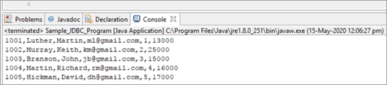
Java Program - Oracle
import java.sql.*;
public class Sample_JDBC_Program {
public static void main(String[] args) throws ClassNotFoundException, SQLException {
// store the SQL statement in a string
String QUERY = "select * from employee_details“
//register the oracle driver with DriverManager
Class.forName("oracle.jdbc.driver.OracleDriver");
/*Here we have used Java 8 so opening the connection in try statement*/
try(Connection conn = DriverManager.getConnection("jdbc:oracle:thin:system/pass123@localhost:1521:XE"))
{
Statement statemnt1 = conn.createStatement();
//Created statement and execute it
ResultSet rs1 = statemnt1.executeQuery(QUERY);
{
//Get the values of the record using while loop
while(rs1.next())
{
int empNum = rs1.getInt("empNum");
String lastName = rs1.getString("lastName");
String firstName = rs1.getString("firstName");
String email = rs1.getString("email");
String deptNum = rs1.getString("deptNum");
String salary = rs1.getString("salary");
//store the values which are retrieved using ResultSet and print it
System.out.println(empNum + "," +lastName+ "," +firstName+ "," +email +","+deptNum +"," +salary);
}
}
}
catch (SQLException e) {
//If exception occurs catch it and exit the program
e.printStackTrace();
}
}
}
Dr.Maivizhi Assistant Professor / CINTEL

Slide 43
Java Program - Mysql
import java.sql.*;
public class javamysql {
public static void main(String arg[])
{ Connection connection = null;
try {
// below two lines are used for connectivity.
Class.forName("com.mysql.cj.jdbc.Driver");
connection = DriverManager.getConnection("jdbc:mysql://localhost:3306/mydb","mydbuser", "mydbuser");
// mydb is database; mydbuser is name of database ;mydbuser is password of database
Statement statement;
statement = connection.createStatement();
ResultSet resultSet;
resultSet = statement.executeQuery("select * from designation");
int code;
String title;
while (resultSet.next()) {
code = resultSet.getInt("code");
title = resultSet.getString("title").trim();
System.out.println("Code : " + code + " Title : " + title);
}
resultSet.close();
statement.close();
connection.close();
}
catch (Exception exception) {
System.out.println(exception);
}
}
}
Dr.Maivizhi Assistant Professor / CINTEL

Slide 44
JAVA APPLETS
Learning Objectives:
Introduction
CUI (Character User Interface)
GUI (Graphical User Interface)
Abstract Window Toolkit (AWT)
What are Applets in Java?
Applet Basics
Life Cycle of an Applet
Types of Applets in Java
How to run an Applet
Sample Applet Programs
Advantages and Disadvantages
Applet Features over HTML
28-08-2023
Dr.Maivizhi Assistant Professor / CINTEL

Slide 45
JAVA APPLETS
Introduction
There are two ways that users can interact with the programme:
They are:
CUI (Character User Interface)
GUI (Graphical User Interface)
Character User Interface(CUI):
In CUI user interacts with the application by typing characters or commands. In CUI user should remember the commands. It is not user friendly.
Example: In a Java program, we can add two numbers(integers) , declare the numbers, do the addition, and report the results. It makes it hard for the end user to understand how to interact with this program throughout compilation and execution (feed input and get outcomes).
Let's take into consideration that the aforementioned program can have the user-friendly (GUI) following configuration:
Whenever the end-user compile the program, can enter two numbers in the given space and clicking on the “equal button”, can get the results in the specified space, which is easy to understand. This is an example for GUI for addition of two numbers.
Enter number 1 (integer)
+
Enter number 2 (integer)
=
Result (Addition of Two integer numbers)
28-08-2023
Dr.Maivizhi Assistant Professor / CINTEL
Notes:
Program is a set of instructions to perform certain task.
The programmer develop the program – This activity is known as “programming”
If we put different programs together – known as “software”

Slide 46
JAVA APPLETS
Graphical User Interface (GUI)
Java Abstract Window Toolkit (AWT) is an Application Program Interface (API) to develop GUI or window-based application in java. The Abstract Window Toolkit(AWT) support for applets. The AWT contains numerous classes and methods that allow you to create and manage the GUI window.
Abstract Window Toolkit (AWT)
AWT is an Application programming interface (API) for creating Graphical User Interface (GUI) in Java. It allows Java programmers to develop window-based applications.
AWT represents a class library to develop applications using GUI.
AWT provides various components like button, label, checkbox, etc. used as objects inside a Java Program. AWT components use the resources of the operating system, i.e., they are platform-dependent, which means, component's view can be changed according to the view of the operating system. The classes for AWT are provided by the Java.awt package for various AWT components.
The Java.awt package contains classes and interfaces that help create graphical user interfaces and enable more user-friendly programme interaction.
28-08-2023
Dr.Maivizhi Assistant Professor / CINTEL
Notes:
Program is a set of instructions to perform certain task.
The programmer develop the program – This activity is known as “programming”
If we put different programs together – known as “software”

Slide 47
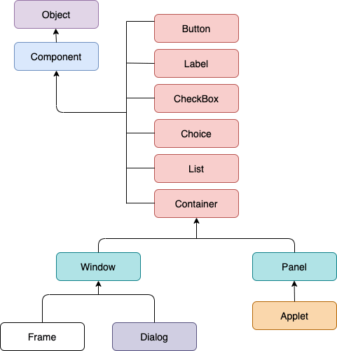
JAVA APPLETS
The hierarchy of Java AWT :
28-08-2023
Dr.Maivizhi Assistant Professor / CINTEL
Notes:
Program is a set of instructions to perform certain task.
The programmer develop the program – This activity is known as “programming”
If we put different programs together – known as “software”

Slide 48
JAVA APPLETS
Object Class:
Object class is the superclass of all Java classes. All Java classes inherited from this class.
Component Class:
The component class, which takes the top position in the AWT hierarchy, is an abstract class that contains all of the component's screen-visible characteristics. The Component object gives details about the foreground and background colours that are currently selected. Additionally, it provides information about the presently selected font colour.
Container:
A component called the container includes additional components like a button, textfield, label, etc. It is a subclass of the Component class, too.
Panel:
The panel can be defined as a container that can be used to hold other components. However, it doesn't contain the title bar, menu bar, or border.
Window:
A window can be defined as a container that doesn't contain any border or menu bar. It creates a top-level view. However, we must have a frame, dialog, or another window for creating a window.
Frame:
The frame is a subclass of Window. It can be defined as a container with components like button, textfield, label, etc. In other words, AWT applications are mostly created using frame container.
28-08-2023
Dr.Maivizhi Assistant Professor / CINTEL

Slide 49
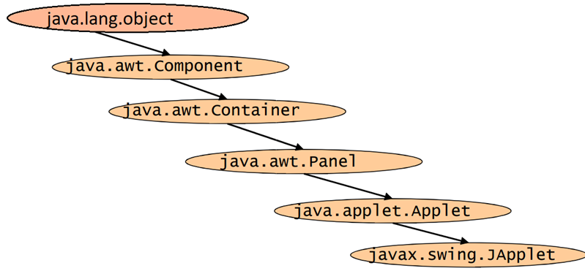
JAVA APPLETS
What are Applets in Java?
The interactive components of web applications are provided by Java applets, which can be easily run by many different platforms' browsers. They can launch automatically when the pages are browsed and are tiny, portable Java programmes embedded in HTML pages.
Applet inherits awt Component class and awt Container class
28-08-2023
Dr.Maivizhi Assistant Professor / CINTEL

Slide 50
JAVA APPLETS
Applet Basics:
All applets are subclasses of Applet. Thus, all applets must import java.applet. Applets must also import java.awt package.
Applets are not executed by the console-based Java run-time interpreter. Rather, they are executed by either a Web browser or an applet viewer.
Execution of an applet does not begin at main( ) [In other words, there is no main() method in an Applet]. Output to your applet’s window is not performed by System.out.println( ). Rather, it is handled with various AWT methods, such as drawString( ), which outputs a string to a specified X,Y location. Input is also handled differently than in an application.
Once an applet has been compiled, it is included in an HTML file using the APPLET tag. The applet will be executed by a Java-enabled web browser when it encounters the APPLET tag within the HTML file.
To view and test an applet more conveniently, simply include a comment at the head of your Java source code file that contains the APPLET tag.
28-08-2023
Dr.Maivizhi Assistant Professor / CINTEL

Slide 51
JAVA APPLETS
Java applets are one of three kinds of Java programs:
An application is a standalone program that can be invoked from the command line.
An applet is a program that runs in the context of a browser session.
A servlet is a program that is invoked on demand on a server program and that runs in the context of a web server process.
28-08-2023
Dr.Maivizhi Assistant Professor / CINTEL

Slide 52
JAVA APPLETS
Applets are programs stored on a web server, like web pages.
When an applet is referred to in a web page that has been fetched and processed by a browser, the browser generates a request to fetch (or download) the applet program, then executes the program in the browser’s execution context, on the client host.
28-08-2023
Dr.Maivizhi Assistant Professor / CINTEL

Slide 53
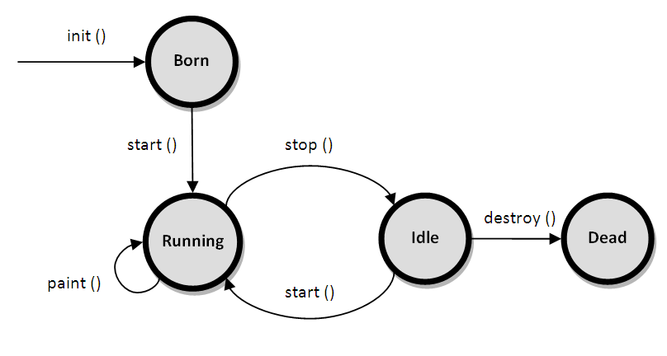
JAVA APPLETS
Life Cycle of an Applet
It's essential in understanding the sequence whereby the different methods indicated in the figure are invoked. The following methods are called in this order when an applet begins:
init( )
start( )
paint( )
When an applet is terminated, the following sequence of method calls takes place:
stop( )
destroy( )
28-08-2023
Dr.Maivizhi Assistant Professor / CINTEL

Slide 54
JAVA APPLETS
public void init(): is used to initialized the Applet. It is invoked only once.
public void start(): is invoked after the init() method or browser is maximized. It is used to start the Applet.
public void stop(): is used to stop the Applet. It is invoked when Applet is stop or browser is minimized.
public void destroy(): is used to destroy the Applet. It is invoked only once.
public void paint(Graphics g): is used to paint the Applet. It provides Graphics class object that can be used for drawing oval, rectangle, arc etc. Within the method paint() we will call the drawString() method to print a text message in the applet window.
28-08-2023
Dr.Maivizhi Assistant Professor / CINTEL

Slide 55
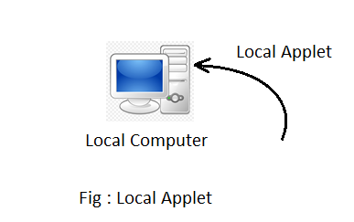
JAVA APPLETS
Types of Applets in Java
Local Applet
Remote Applet
Local Applet
Local Applet is developed locally and stored in the local system. A web page doesn't need the get the information from the internet when it finds the local Applet in the system. It is specified or defined by the file name or pathname. There are two attributes used in defining an applet, i.e., the codebase that specifies the path name and code that defined the name of the file that contains Applet's code..
Example:
<applet
codebase = “MyOwnApplet"
code = “FirstApplet.class"
width = 120
height = 120>
</applet>
28-08-2023
Dr.Maivizhi Assistant Professor / CINTEL

Slide 56
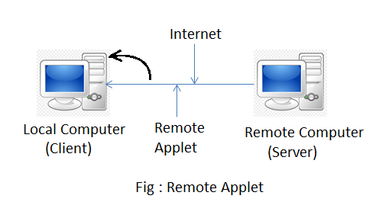
JAVA APPLETS
JAVA APPLETS
Remote Applet
Remote applets are stored in a remote computer and an Internet connection is needed to access them. The remote applet is designed and developed by other developers. To find and load a remote applet, you need to know the address of the network applet, i.e., the Uniform Resource Locator (URL).
Example:
<applet
codebase = "http://www.myconnect.com/applets/"
code = "FirstApplet.class"
width = 120
height =120>
</applet>
28-08-2023
Dr.Maivizhi Assistant Professor / CINTEL

Slide 57
JAVA APPLETS
JAVA APPLETS
Difference between Local Applet and Remote Applet:
Local Applet | Remote Applet
There is no need to define the Applet's URL in Local Applet. | We need to define the Applet's URL in Remote Applet.
Local Applet is available on our computer. | Remote Applet is not available on our computer.
To use it or access it, we don't need Internet Connection. | To use it or access it on our computer, we need an Internet Connection.
It is written on our own and then embedded into the web pages. | It was written by another developer.
We don't need to download it. | It is available on a remote computer, so we need to download it to our system.
28-08-2023
Dr.Maivizhi Assistant Professor / CINTEL

Slide 58
JAVA APPLETS
JAVA APPLETS
How to run an applet
An applet can be run two ways:
Through HTML file.
Using the appletviewer tool (for testing purposes).
1. Through HTML file:
For an applet to run in a web browser, we must write a short HTML text file that contains a tag to load an applet. For this, we can use <applet> or <object> tags. The HTML <applet> tag specifies an applet. It embeds Java applets in HTML documents. It does not support HTML5.
28-08-2023
Dr.Maivizhi Assistant Professor / CINTEL

Slide 59
JAVA APPLETS
JAVA APPLETS
Through HTML file:
<!DOCTYPE html>
<html>
<head>
<title>HTML applet Tag</title>
</head>
<body>
<applet code = “FirstApplet.class" width = "300" height = "200"></applet>
</body>
</html>
In the HTML text file above, the code attribute of the <applet> tag specifies the applet class to execute.
The width and height attributes are also required. They define the initial size of the panel on which the applet is running.
The applet command must be closed with the </applet> tag.
28-08-2023
Dr.Maivizhi Assistant Professor / CINTEL

Slide 60
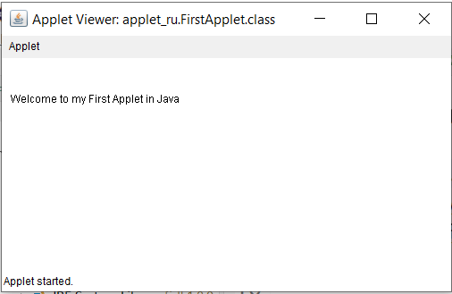
JAVA APPLETS
JAVA APPLETS
Below is the applet class embedded in the HTML file above:
import java.applet.*;
import java.awt.*;
public class FirstApplet extends Applet
{
public void paint (Graphics gh)
{
gh.drawString(“Weclome to my first applet..!”,300, 150);
}
}
28-08-2023
Dr.Maivizhi Assistant Professor / CINTEL

Slide 61
JAVA APPLETS
JAVA APPLETS
2. Using the appletviewer tool:
The appletviewer runs an applet in the window. It is usually the fastest and easiest way to test an applet. Create an applet containing the <applet> tag in the comment and compile it. It is for testing purposes only.
//FirstApplet.java
import java.applet.Applet;
import java.awt.Graphics;
public class FirstApplet extends Applet
{
public void paint(Graphics g)
{
g.drawString("welcome to my first applet",10,50);
}
}
/* This is saved as FirstApplet.html
<applet code="FirstApplet.class" width="300" height="300">
</applet>
*/
To run an applet using the appletviewer tool, write in the command prompt:
c:\>javac FirstApplet.java
c:\>appletviewer FirstApplet.java
c:\>appletviewer FirstApplet.html
Here,
javac is the compiler that compiles java codes using a command line.
FirstApplet.java is the applet class to be tested.
appletviewer is a tool that tests the applet class.
28-08-2023
Dr.Maivizhi Assistant Professor / CINTEL

Slide 62
Output
JAVA APPLETS
JAVA APPLETS
28-08-2023
Dr.Maivizhi Assistant Professor / CINTEL

Slide 63
JAVA APPLETS
JAVA APPLETS
Sample Applet Program-2:
package applet_ru;
import java.awt.*;
import java.applet.*;
public class LoginPage extends Applet
{
TextField Uname,pass;
Button b1,b2;
public void init()
{
Label n=new Label(“UserName:",Label.CENTER);
Label p=new Label("password:",Label.CENTER);
Uname=new TextField(20);
pass=new TextField(20);
pass.setEchoChar('$');
b1=new Button("submit");
b2=new Button("cancel");
add(n);
add(Uname);
add(p);
add(pass);
add(b1);
add(b2);
n.setBounds(70,90,90,60);
p.setBounds(70,130,90,60);
Uname.setBounds(280,100,90,20);
pass.setBounds(200,140,90,20);
b1.setBounds(100,260,70,40);
b2.setBounds(180,260,70,40);
}
public void paint(Graphics g)
{ repaint();
}
}
28-08-2023
Dr.Maivizhi Assistant Professor / CINTEL

Slide 64
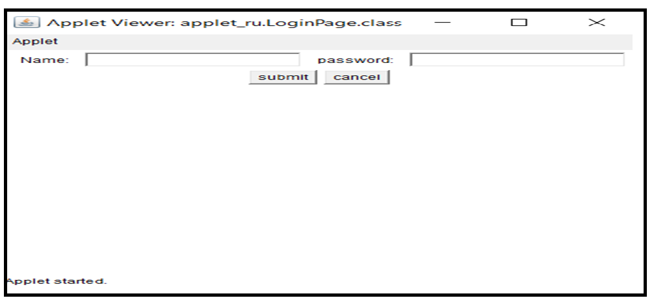
Output:
JAVA APPLETS
JAVA APPLETS
28-08-2023
Dr.Maivizhi Assistant Professor / CINTEL

Slide 65
JAVA APPLETS
JAVA APPLETS
Sample Applet Program-3
import java.applet.*;
import java.awt.*;
import java.awt.event.*;
public class AppletSample3 extends Applet implements ActionListener {
public void init() {
Label label1 = new Label("TEXT1: ");
textField1 = new TextField("WELCOME");
swapBtn = new Button("SwapButton");
swapBtn.addActionListener(this);
Label label2 = new Label("TEXT2: ");
textField2 = new TextField("GREETINGS!");
textField2.setEditable(false);
add(label1);
add(textField1);
add(swapBtn);
add(label2);
add(textField2);
}
public void actionPerformed(ActionEvent e) {
String temp = textField1.getText();
textField1.setText(textField2.getText());
textField2.setText(temp);
}
TextField textField1, textField2;
Button swapBtn;
}
The above applet program is used to swap Text1 string to Text2 and vice versa while clicking on the button “SwapButton”.
28-08-2023
Dr.Maivizhi Assistant Professor / CINTEL

Slide 66
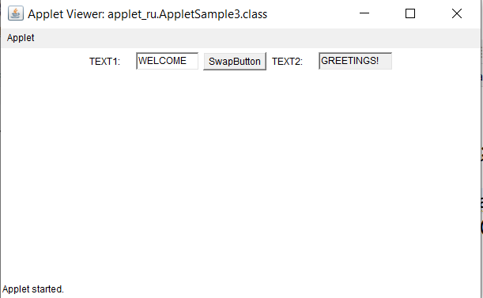
Output:
JAVA APPLETS
JAVA APPLETS
28-08-2023
Dr.Maivizhi Assistant Professor / CINTEL

Slide 67
JAVA APPLETS
JAVA APPLETS
Commonly used methods of Graphics class:
1. public abstract void drawString(String str, int x, int y): is used to draw the specified string.
2. public void drawRect(int x, int y, int width, int height): draws a rectangle with the specified width and height.
3. public abstract void fillRect(int x, int y, int width, int height): is used to fill rectangle with the default color and specified width and height.
4. public abstract void drawOval(int x, int y, int width, int height): is used to draw oval with the specified width and height.
5. public abstract void fillOval(int x, int y, int width, int height): is used to fill oval with the default color and specified width and height.
6. public abstract void drawLine(int x1, int y1, int x2, int y2): is used to draw line between the points(x1, y1) and (x2, y2).
7. public abstract boolean drawImage(Image img, int x, int y, ImageObserver observer): is used draw the specified image.
8. public abstract void drawArc(int x, int y, int width, int height, int startAngle, int arcAngle): is used draw a circular or elliptical arc.
9. public abstract void fillArc(int x, int y, int width, int height, int startAngle, int arcAngle): is used to fill a circular or elliptical arc.
10.public abstract void setColor(Color c): is used to set the graphics current color to the specified color.
11.public abstract void setFont(Font font): is used to set the graphics current font to the specified font.
28-08-2023
Dr.Maivizhi Assistant Professor / CINTEL

Slide 68
JAVA APPLETS
JAVA APPLETS
Some of the AWT supplies User Interface components
Text Fields
Text area
Labels
Checkboxes
Buttons
Lists
Sliders and scrollbars
Drawing areas
Menus
Containers
28-08-2023
Dr.Maivizhi Assistant Professor / CINTEL

Slide 69
JAVA APPLETS
JAVA APPLETS
EVENT HANDLING
The pathway to efficient applet programming is how to handle events. The majority of events to which the applet will react come from the user. The most frequent various types of events processed involve those triggered by the keyboard, mouse, and various controllers, including push buttons. Events are supported by the java.awt.event package.
Steps to perform Event Handling
Register the component with the Listener
Registration Methods
For registering the component with the Listener, many classes provide the registration methods.
For example:
Button | public void addActionListener(ActionListener a){}
MenuItem | public void addActionListener(ActionListener a){}
TextField | public void addActionListener(ActionListener a){} public void addTextListener(TextListener a){}
TextArea | public void addTextListener(TextListener a){}
Checkbox | public void addItemListener(ItemListener a){}
Choice | public void addItemListener(ItemListener a){}
List | public void addActionListener(ActionListener a){} public void addItemListener(ItemListener a){}
28-08-2023
Dr.Maivizhi Assistant Professor / CINTEL

Slide 70
JAVA APPLETS
JAVA APPLETS
Advantages of applets
The response time is quicker because it operates on the client-side.It is secured.
Web browsers must adhere to tight security regulations while using applets.
It is compatible with browsers on various operating systems, including Linux, Windows, and Mac OS.
Disadvantages of applets
The client browser requires a plugin to run the applet.
The mobile browser on iOS or Android does not run any Java applets. Desktop browsers have dropped support for Java applets along with the rise of mobile operating systems.
Applet features over HTML
It displays the dynamic web pages of a web application.
Play audio files.
Display documents.
Play animations.
28-08-2023
Dr.Maivizhi Assistant Professor / CINTEL

Slide 71
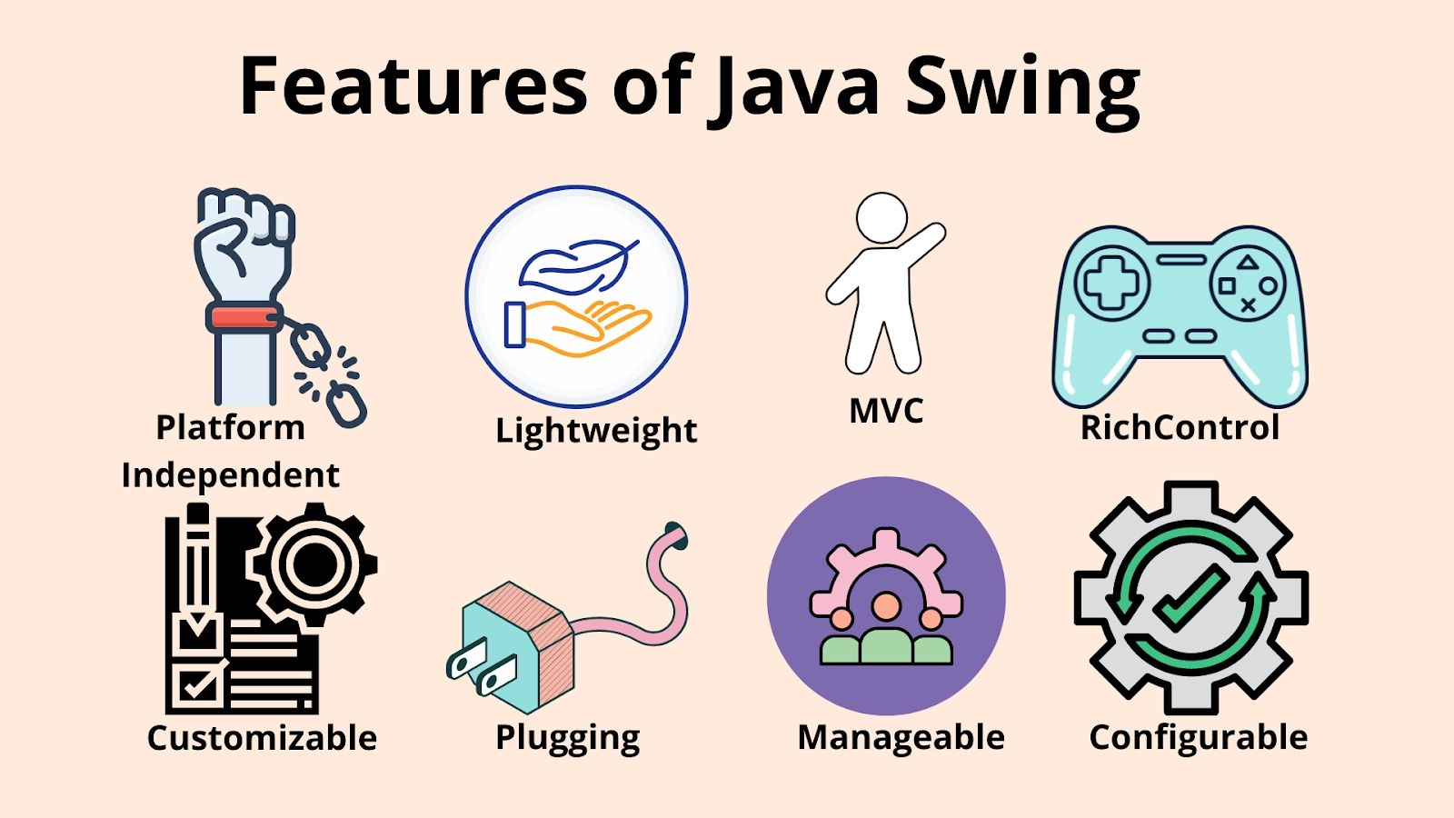
Java SWING - Introduction
Swing in Java is a lightweight and platform-independent class of the Java foundation class. It's used to make applications that run in windows.
It contains elements such as a button, a scroll bar, and a text field. A graphical user interface is created by combining all of these elements.
Swing Framework includes several classes that provide more vital and more versatile GUI (Graphical User Interface) components than AWT(Abstract Window Toolkit).
Swing is a Sun Microsystems-published official Java GUI toolkit that closely resembles the look and feels of modern Java GUIs. It is used to create the graphical user interface for Java Class.
28-08-2023
Dr.Maivizhi Assistant Professor / CINTEL

Slide 72
Java SWING FEATURES
Platform Independent
It is platform-independent, as the swing components used to construct the program are not platform-specific. It works on any platform and in any location.
Customizable
Swing controls are simple to customize. It can be changed, and the swing component application's visual appearance is independent of its internal representation.
Plugging
Java Swing has pluggable look and feel. This feature allows users to change the appearance and feel of Swing components without having to restart the application.
The Swing library will enable components to have the same look and feel across all platforms, regardless of where the program is running.
The Swing library provides an API that allows complete control over the appearance and feel of an application's graphical user interface
28-08-2023
Dr.Maivizhi Assistant Professor / CINTEL

Slide 73
Java SWING FEATURES(Contd.)
MVC stands for Model-View-Controller.
The model agrees with the state information associated with the Component in MVC terminology.
The view determines how the component appears on screen and any aspects of the view that are influenced by the model's current state.
The controller is in charge of determining how the component responds to the user.
Manageable Look and Feel
It's simple to manage and configure.
Its mechanism and composition pattern allows changes to be made to the settings while the program runs.
Constant changes to the application code can be made without making any changes to the user interface.
28-08-2023
Dr.Maivizhi Assistant Professor / CINTEL

Slide 74
Java SWING FEATURES (Contd.)
Lightweight
Lightweight Components: The JDK's AWT has supported lightweight component development.
A component must not rely on non-Java [O/s based] system classes to be considered light.
The look and feel classes in Java help Swing components have their view.
28-08-2023
Dr.Maivizhi Assistant Professor / CINTEL

Slide 75
JFC and Swing
JFC stands for Java Foundation Classes, a set of classes used to create graphical user interfaces (GUIs) and add rich graphical features and interactivity to Java applications.
The Java Classes Foundation holds Java Swing (JFC).
28-08-2023
Dr.Maivizhi Assistant Professor / CINTEL

Slide 76
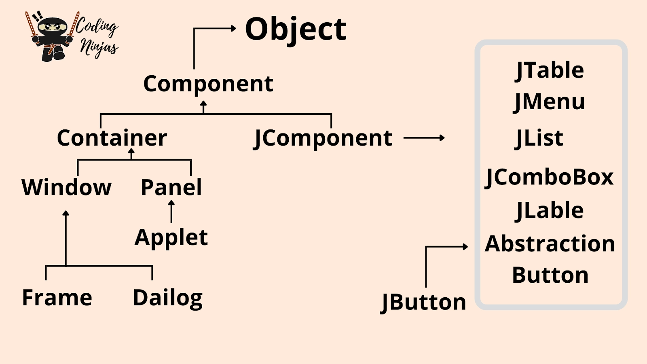
Swing Hierarchy
JFC stands for Java Foundation Classes, a set of classes used to create graphical user interfaces (GUIs) and add rich graphical features and interactivity to Java applications. The Java Classes Foundation holds Java Swing (JFC).
28-08-2023
Dr.Maivizhi Assistant Professor / CINTEL

Slide 77
What are Swing Components in Java?
A component is independent visual control, and Java Swing Framework contains a large set of these components, providing rich functionalities and allowing high customization.
They all are derived from JComponent class. All these components are lightweight components.
This class offers some standard functionality like pluggable look and feel, support for accessibility, drag and drop, layout, etc.
A container holds a group of components.
It delivers a space where a component can be managed and displayed. Containers are of two types:
28-08-2023
Dr.Maivizhi Assistant Professor / CINTEL

Slide 78
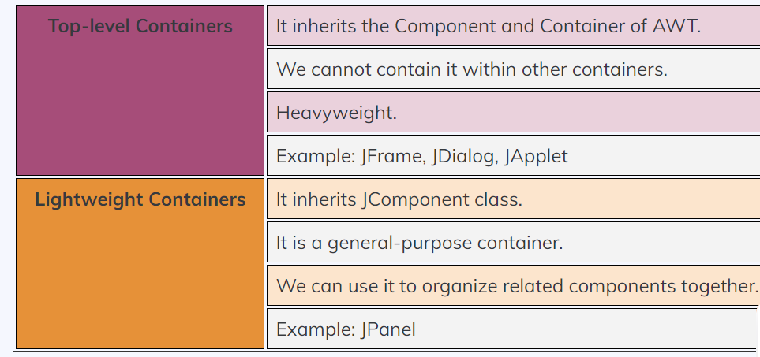
Swing Components
28-08-2023
Dr.Maivizhi Assistant Professor / CINTEL

Slide 79
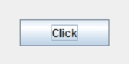
Top Swing components in Java
Jbutton
JButton class to create a push button on the UI.
The button can include some display text or images.
It yields an event when clicked and double-clicked.
Can implement a JButton in the application by calling one of its constructors.
Syntax:
JButton okBtn = new JButton(“Click”);
Display:
28-08-2023
Dr.Maivizhi Assistant Professor / CINTEL

Slide 80
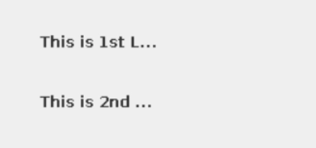
JLabel
Use JLabel class to render a read-only text label or images on the UI. It does not generate any event.
Syntax:
JLabel textLabel = new JLabel(“This is 1st L...”);
This constructor returns a label with specified text.
JLabel imgLabel = new JLabel(carIcon);
It returns a label with a car icon.
The JLabel Contains four constructors. They are as follows:
JLabel()
JLabel(String s)
JLabel(Icon i)
JLabel(String s, Icon i, int horizontalAlignment)
28-08-2023
Dr.Maivizhi Assistant Professor / CINTEL

Slide 81
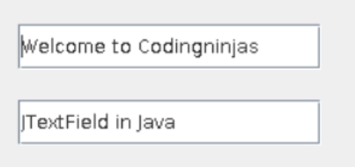
JTextField
The JTextField renders an editable single-line text box. Users can input non-formatted text in the box.
Can initialize the text field by calling its constructor and passing an optional integer parameter.
This parameter sets the box width measured by the number of columns.
Also, it does not limit the number of characters that can be input into the box.
Syntax:
JTextField txtBox = new JTextField(50);
It is the most widely used text component.
It has three constructors:
JTextField(int cols)
JTextField(String str, int cols)
JTextField(String str)
Note: cols represent the number of columns in the text field.
28-08-2023
Dr.Maivizhi Assistant Professor / CINTEL

Slide 82
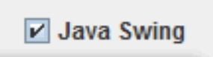
JCheckBox
The JCheckBox renders a check-box with a label.
The check-box has two states, i.e., on and off. On selecting, the state is set to "on," and a small tick is displayed inside the box.
Syntax:
CheckBox chkBox = new JCheckBox(“Java Swing”, true);
It returns a checkbox with the label Pepperoni pizza.
Notice the second parameter in the constructor.
It is a boolean value that denotes the default state of the check-box.
True means the check-box defaults to the "on" state.
28-08-2023
Dr.Maivizhi Assistant Professor / CINTEL

Slide 83
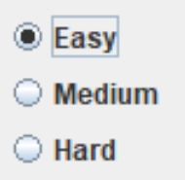
JRadioButton
A radio button is a group of related buttons from which can select only one.
Use JRadioButton class to create a radio button in Frames and render a group of radio buttons in the UI.
Users can select one choice from the group.
Syntax:
JRadioButton jrb = new JRadioButton("Easy");
Display:
28-08-2023
Dr.Maivizhi Assistant Professor / CINTEL

Slide 84
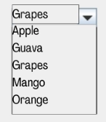
JComboBox
The combo box is a combination of text fields and a drop-down list
Use JComboBox component to create a combo box in Swing.
Syntax:
JcomboBox jcb = new JComboBox(name);
JTextArea
In Java, the Swing toolkit contains a JTextArea Class. It is under package javax.swing.JTextArea class. It is used for displaying multiple-line text.
Declaration:
public class JTextArea extends JTextComponent
28-08-2023
Dr.Maivizhi Assistant Professor / CINTEL

Slide 85
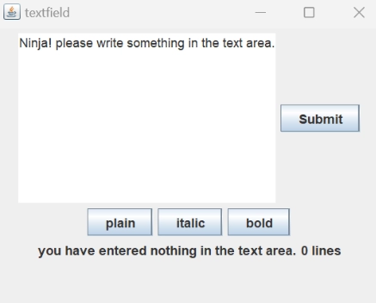
Syntax:
JTextArea textArea_area=new JTextArea("Ninja! please write something in the text area.");
The JTextArea Contains four constructors. They are as follows:
JTextArea()
JTextArea(String s)
JTextArea(int row, int column)
JTextArea(String s, int row, int column)
Display:
28-08-2023
Dr.Maivizhi Assistant Professor / CINTEL

Slide 86
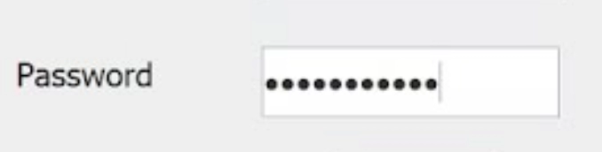
JPasswordField
In Java, the Swing toolkit contains a JPasswordField Class.
It is under package javax.swing.JPasswordField class.
It is specifically used for the password, and we can edit them.
Declaration:
public class JPasswordField extends JTextField
Syntax:
JPasswordField password = new JPasswordField();
The JPasswordFieldContains 4 constructors. They are as follows:
JPasswordField()
JPasswordField(int columns)
JPasswordField(String text)
JPasswordField(String text, int columns)
28-08-2023
Dr.Maivizhi Assistant Professor / CINTEL

Slide 87

JTable
In Java, the Swing toolkit contains a JTable Class.
It is under package javax.swing.JTable class.
It is used to draw a table to display data.
Syntax:
JTable table = new JTable(table_data, table_column);
The JTable contains two constructors. They are as follows:
JTable()
JTable(Object[][] rows, Object[] columns)
28-08-2023
Dr.Maivizhi Assistant Professor / CINTEL

Slide 88
JList
In Java, the Swing toolkit contains a JList Class.
It is under package javax.swing.JList class.
It is used to represent a list of items together.
We can select one or more than one items from the list.
Declaration:
public class JList extends JComponent implements Scrollable, Accessible
Syntax:
DefaultListModel<String> list1 = new DefaultListModel<>();
list1.addElement("Apple");
list1.addElement("Orange");
list1.addElement("Banan");
list1.addElement("Grape");
JList<String> list_1 = new JList<>(list1);
28-08-2023
Dr.Maivizhi Assistant Professor / CINTEL

Slide 89

The JListContains 3 constructors. They are as follows:
JList()
JList(ary[] listData)
JList(ListModel<ary> dataModel)
Display:
28-08-2023
Dr.Maivizhi Assistant Professor / CINTEL

Slide 90

JOptionPane
In Java, the Swing toolkit contains a JOptionPane Class. It is under package javax.swing.JOptionPane class. It is used for creating dialog boxes for displaying a message, confirm box, or input dialog box.
Declaration:
public class JOptionPane extends JComponent implements Accessible
Syntax:
JOptionPane.showMessageDialog(jframe_obj, "Good Morning, Evening & Night.");
The JOptionPaneContains 3 constructors. They are as following:
JOptionPane()
JOptionPane(Object message)
JOptionPane(Object message, intmessageType)
28-08-2023
Dr.Maivizhi Assistant Professor / CINTEL

Slide 91

JScrollBar
In Java, the Swing toolkit contains a JScrollBar class.
It is under package javax.swing.JScrollBar class.
It is used for adding horizontal and vertical scrollbars.
Declaration:
public class JScrollBar extends JComponent implements Adjustable, Accessible
Syntax:
JScrollBar scrollBar = new JScrollBar();
The JScrollBarContains 3 constructors. They are as following:
JScrollBar()
JScrollBar(int orientation)
JScrollBar(int orientation, int value, int extent, int min_, intmax_)
28-08-2023
Dr.Maivizhi Assistant Professor / CINTEL

Slide 92
JMenuBar, JMenu and JMenuItem
In Java, the Swing toolkit contains a JMenuBar, JMenu, and JMenuItem class.
It is under package javax.swing.JMenuBar, javax.swing.JMenu and javax.swing.JMenuItem class.
The JMenuBar class is used for displaying menubar on the frame.
The JMenu Object is used to pull down the menu bar's components.
The JMenuItem Object is used for adding the labeled menu item.
JMenuBar, JMenu and JMenuItem Declarations:
public class JMenuBar extends JComponent implements MenuElement, Accessible
public class JMenu extends JMenuItem implements MenuElement, Accessible
public class JMenuItem extends AbstractButton implements Accessible, MenuElement
28-08-2023
Dr.Maivizhi Assistant Professor / CINTEL

Slide 93

Syntax:
JMenuBar menu_bar = new JMenuBar();
JMenu menu = new JMenu("Menu");
menuItem1 = new JMenuItem("Never");
menuItem2 = new JMenuItem("Stop");
menuItem3 = new JMenuItem("Learing");
menu.add(menuItem1);
menu.add(menuItem2);
menu.add(menuItem3);
28-08-2023
Dr.Maivizhi Assistant Professor / CINTEL

Slide 94

JPopupMenu
In Java, the Swing toolkit contains a JPopupMenu Class.
It is under package javax.swing.JPopupMenu class.
It is used for creating popups dynamically on a specified position.
Declaration:
public class JPopupMenu extends JComponent implements Accessible, MenuElement
Syntax:
final JPopupMenu popupmenu1 = new JPopupMenu("Edit");
The JPopupMenuContains 2 constructors. They are as follows:
JPopupMenu()
JPopupMenu(String label)
28-08-2023
Dr.Maivizhi Assistant Professor / CINTEL

Slide 95

JCheckBoxMenuItem
In Java, the Swing toolkit contains a JCheckBoxMenuItem Class.
It is under package javax.swing.JCheckBoxMenuItem class.
It is used to create a checkbox on a menu.
Syntax:
JCheckBoxMenuItem item = new JCheckBoxMenuItem("Option_1");
The JCheckBoxMenuItem Contains 2 constructors. They are as following:
JCheckBoxMenuItem()
JCheckBoxMenuItem(Action a)
JCheckBoxMenuItem(Icon icon)
JCheckBoxMenuItem(String text)
JCheckBoxMenuItem(String text, boolean b)
JCheckBoxMenuItem(String text, Icon icon)
JCheckBoxMenuItem(String text, Icon icon, boolean b)
28-08-2023
Dr.Maivizhi Assistant Professor / CINTEL

Slide 96

JSeparator
In Java, the Swing toolkit contains a JSeparator Class.
It is under package javax.swing.JSeparator class.
It is used for creating a separator line between two components.
Declaration:
public class JSeparator extends JComponent implements SwingConstants, Accessible
Syntax:
jmenu_Item.addSeparator();
The JSeparatorContains 2 constructors. They are as following:
JSeparator()
JSeparator(int orientation)
28-08-2023
Dr.Maivizhi Assistant Professor / CINTEL

Slide 97
Model-View-Controller
MVC is a blueprint for organizing code which represents one of several design patterns. To understand the need for these patterns, think about good and bad software.
Good software is easy to change and work with, while bad software is difficult to modify. Design patterns help us create the good kind of software.
Software evolves over time due to various factors:
A new feature needs to be added.
A bug needs to be fixed.
Software needs to be optimized.
The software design needs to be improved.
Indicators of bad software includes:
Rigidity – Software requires a cascade of changes when a change is made in one place.
Fragility – Software breaks in multiple places when a change is made.
Needless complexity – Software is overdesigned to handle any possible change.
Needless repetition – Software contains duplicate code.
28-08-2023
Dr.Maivizhi Assistant Professor / CINTEL

Slide 98
Model-View-Controller
Software can be intentionally designed to handle changes that might occur later on.
The best approach is to create components in the application that are loosely connected to each other.
In a loosely coupled application, you can make a change to one component of an application without making changes to other parts.
There are several principles that enable reducing dependencies between different parts of an application.
Software design patterns represent strategies for applying software design principles. MVC is one of those patterns.
In general, a visual component is a composite of three distinct aspects:
The way that the component looks when rendered on the screen
The way that the component reacts to the user
The state information associated with the component
Throughout time, a particular architectural approach has demonstrated remarkable efficiency: namely, the Model-View-Controller, often referred to as MVC.
28-08-2023
Dr.Maivizhi Assistant Professor / CINTEL

Slide 99
Model-View-Controller
The Model-View-Controller (MVC) software design pattern is a method for separating concerns within a software application.
As the name implies, the MVC pattern has three layers:
The Model defines the business layer of the application,
the Controller manages the flow of the application,
the View defines the presentation layer of the application.
Model: Handles data and business logic. Represents the business layer of the application
View: Presents the data to the user whenever asked for. Defines the presentation of the application
Controller: Entertains user requests and fetch necessary resources. Manages the flow of the application
Each of the components has a demarcated set of tasks which ensures smooth functioning of the entire application along with complete modularity.
28-08-2023
Dr.Maivizhi Assistant Professor / CINTEL
99

Slide 100
Model-View-Controller
Model :
Model is where the application’s data objects are stored. It represents knowledge as a structure of objects.
The model doesn’t know anything about views and controllers but it can contain logic to update controller if its data changes.
The model is quite simply the data for our application.
The data is “modelled” in a way it’s easy to store, retrieve, and edit.
The model is how we apply rules to our data, which eventually represents the concepts our application manages.
For any software application, everything is modelled as data that can be handled easily.
What is a user, a book, or a message for an app? Nothing really, only data that must be processed according to specific rules. Like, the date must not be higher than the current date, the email must be in the correct format, the name mustn’t be more than “x” characters long, etc.
28-08-2023
100
Dr.Maivizhi Assistant Professor / CINTEL

Slide 101
Model-View-Controller
Model:
Whenever a user makes any request from the controller, it contacts the appropriate model which returns a data representation of whatever the user requested.
This model will be the same for a particular work, irrespective of how we wish to display it to the user.
That is why we can choose any available view to render the model data.
Additionally, a model also contains the logic to update the relevant controller whenever there is any change in the model’s data.
28-08-2023
Dr.Maivizhi Assistant Professor / CINTEL
101

Slide 102
Model-View-Controller
VIEW:
The view determines how the component is displayed on the screen, including any aspects of the view that are affected by the current state of the model.
View can also update the model by sending appropriate messages. Users interact with an application through its View.
As the name suggests, the view is responsible for rendering the data received from the model. There may be pre-designed templates where you can fit the data, and there may even be several different views per model depending on the requirements.
Any web application is structured keeping these three core components in mind. There may be a primary controller that is responsible for receiving all the requests and calling the specific controller for specific actions.
28-08-2023
Dr.Maivizhi Assistant Professor / CINTEL
102

Slide 103
Model-View-Controller
CONTROLLER:
The controller determines how the component reacts to the user.
Example : When the user clicks a check box, the controller reacts by changing the model to reflect the user’s choice (checked or unchecked).
The controller is like housekeeper of the application – it performs coordination between model and view to entertain a user request. The user requests are received as HTTP get or post request – for example, when the user clicks on any GUI elements to perform any action.
The primary function of a controller is to call and coordinate with the model to fetch any necessary resources required to act.
Usually, on receiving a user request, the controller calls the appropriate model for the task at hand.
28-08-2023
103
Dr.Maivizhi Assistant Professor / CINTEL

Slide 104
Advantages of the MVC Architecture
A common problem faced by application developers these days is the support for different type of devices.
The MVC architecture solves this problem as developers can create different interfaces for different devices, and based on from which device the request is made, the controller will select an appropriate view.
The model sends the same data irrespective of the device being used, which ensures a complete consistency across all devices.
The MVC separation beautifully isolates the view from the business logic.
It also reduces complexities in designing large application by keeping the code and workflow structured.
This makes the overall code much easier to maintain, test, debug, and reuse.
28-08-2023
Dr.Maivizhi Assistant Professor / CINTEL
104

Slide 105

Model-View-Controller
We are going to create a Student object acting as a model.
StudentView will be a view class which can print student details on console
StudentController is the controller class responsible for storing data in the Student object and updating StudentView accordingly.
MVCPatternDemo, our demo class, will use StudentController to demonstrate the use of MVC pattern.
28-08-2023
Dr.Maivizhi Assistant Professor / CINTEL
105

Slide 106
Model-View-Controller
Step 1: Create the Model :
28-08-2023
Dr.Maivizhi Assistant Professor / CINTEL
106

Slide 107
Model-View-Controller
Step 2: Create the View
28-08-2023
Dr.Maivizhi Assistant Professor / CINTEL
107

Slide 108
Model-View-Controller
Step 3: Create the Controller
public class StudentController {
private Student model;
private StudentView view;
public StudentController(Student model, StudentView view) {
this.model = model;
this.view = view;
}
public void setStudentName(String name){
model.setName(name);
}
public String getStudentName(){
return model.getName();
}
public void setStudentRollNo(String rollNo){
model.setRollNo(rollNo);
}
public String getStudentRollNo(){
return model.getRollNo();
}
public void updateView(){
view.printStudentDetails(model.getName(), model.getRollNo());
}
}
28-08-2023
Dr.Maivizhi Assistant Professor / CINTEL
108

Slide 109
Model-View-Controller
Step 4: Create the main Java file
“MVCPatternDemo.java” fetches the student data from the database or a function (in this case we’re using a function to set the values) and pushes it on to the Student model.
Then, it initializes the view we had created earlier.
Further, it also initializes our controller and binds it to the model and the view.
The updateView() method is a part of the controller which updates the student details on the console.
public class MVCPatternDemo {
public static void main(String[] args) {
//fetch student record based on his roll no from the database
Student model = retriveStudentFromDatabase();
//Create a view : to write student details on console
StudentView view = new StudentView();
StudentController controller = new StudentController(model, view);
controller.updateView();
//update model data
controller.setStudentName("John");
controller.updateView();
}
private static Student retriveStudentFromDatabase(){
Student student = new Student();
student.setName("Robert");
student.setRollNo("10");
return student;
}
}
28-08-2023
Dr.Maivizhi Assistant Professor / CINTEL
109

Slide 110
Model-View-Controller
Step 5: Test the Result
Student:
Name: Robert
Roll No: 10
Student:
Name: John
Roll No: 10
28-08-2023
Dr.Maivizhi Assistant Professor / CINTEL
110

Slide 111
Widgets
Graphical User Interface (GUI) elements are the visual components that allow users to interact with software applications.
These elements are often referred to as "widgets," which are essentially building blocks that make up the user interface.
Each widget serves a specific purpose and provides a way for users to input information, view data, or trigger actions. Here is a list of controls in the javax.swing package
Input Components
Buttons ( JButton, JRadioButtons, JCheckBox)
Text (JTextField, JTextArea)
Menus (JMenuBar, JMenu, JMenuItem)
Sliders (JSlider)
JComboBox (uneditable) (JComboBox)
List (Jlist )
28-08-2023
Dr.Maivizhi Assistant Professor / CINTEL
111

Slide 112
Widgets
Information Display Components
JLabel
Progress bars (JProgressBar)
Tool tips (using JComponent's setToolTipText(s) method)
Choosers
File chooser (JFileChooser)
Color chooser (JColorChooser)
More complex displays
Tables (JTable)
Trees (JTree)
28-08-2023
Dr.Maivizhi Assistant Professor / CINTEL
112

